Slide 1

INTRODUCTION TO DATA MANAGEMENT END TERM PRACTICAL
Presented by :
ARJUN PANDEY
Registration number:
11810731
Course code :
Int 217

Slide 2
GROSS DOMESTIC PRODUCT
(GDP)

Slide 3
BRIEF DESCRIPTION OF GDP
Gross domestic product (GDP) is the standard measure of the value added created through the production of goods and services in a country during a certain period.
It also measures the income earned from that production, or the total amount spent on final goods and services.
GDP is the single most important indicator to capture economic activity.

Slide 4
objectives
To analyze GDP growth of country and obtain a trend line.
To analyze that when the world has gone into recessions.
To analyze and know total GDP per category.
To analyze and know the total GDP produced by each country.
To make a visualization in Tableau using world map and placing details respectively.

Slide 5
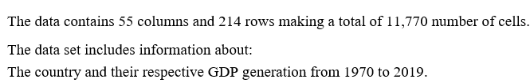
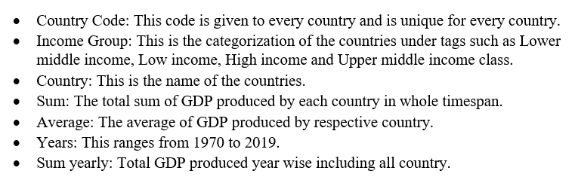
OVERVIEW OF DATASET

Slide 6
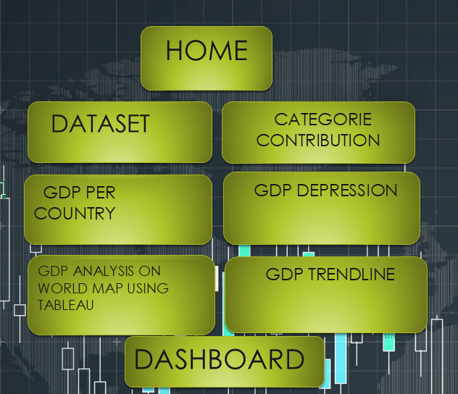
index

Slide 7
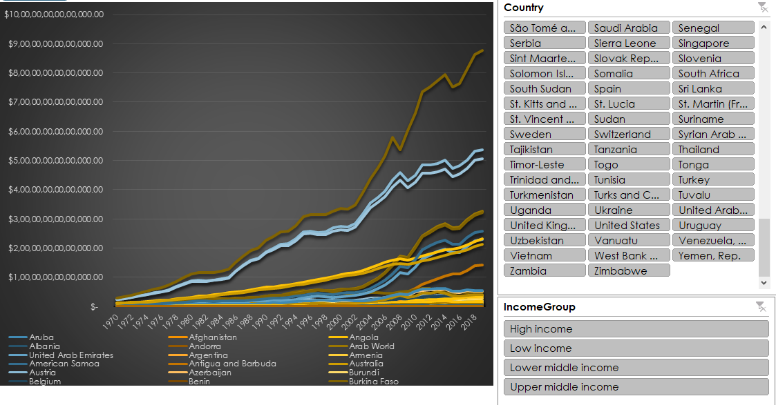
GROSS DOMESTIC PRODUCT (GDP) OF COUNTRY TRENDLINE .

Slide 8
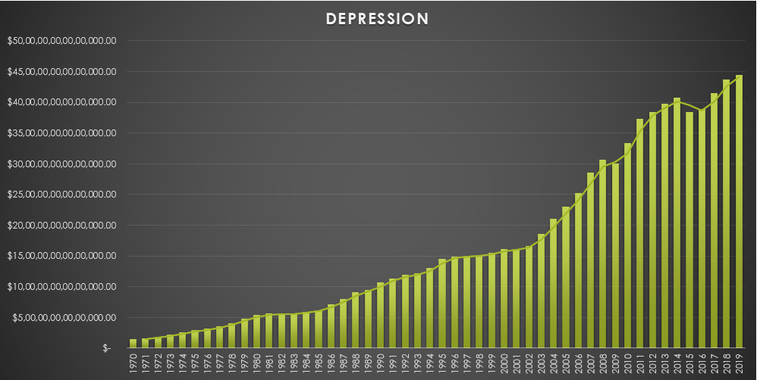
To analyze that when the world has gone into recessions.

Slide 9
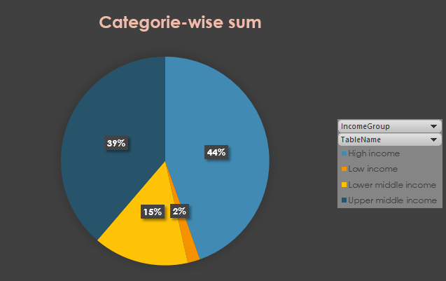
To analyze and know total GDP per category.

Slide 10
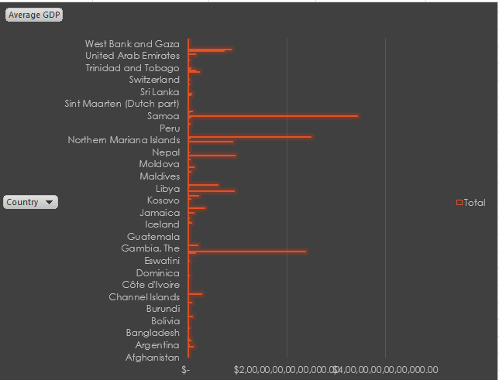
To analyze and know the total GDP produced by each country.

Slide 11
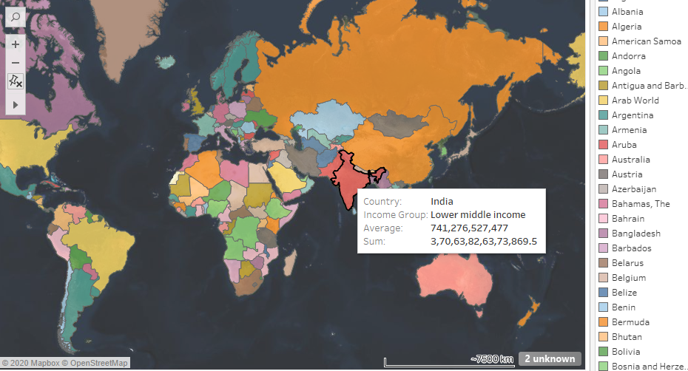
To make a visualization in Tableau using world map and placing details respectively.

Slide 12
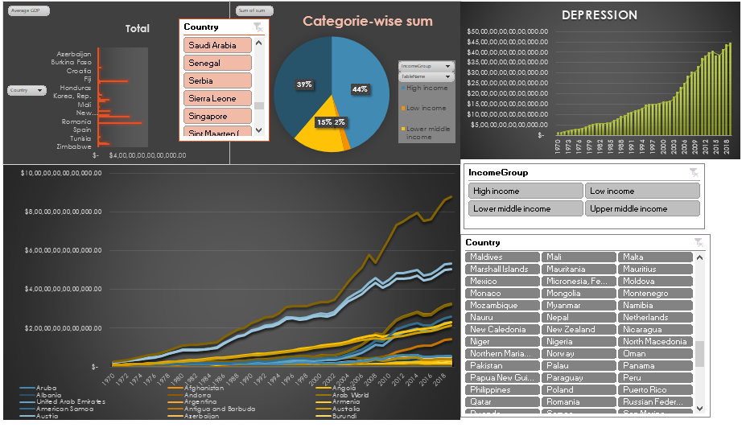
dashboard

Slide 13
THANK YOU

